Slide 1
CRIME + NFL
Team CAKI
(Chad, Alec, Karl, Iris)

Slide 2
MAP of Where Crimes Happens

Slide 3
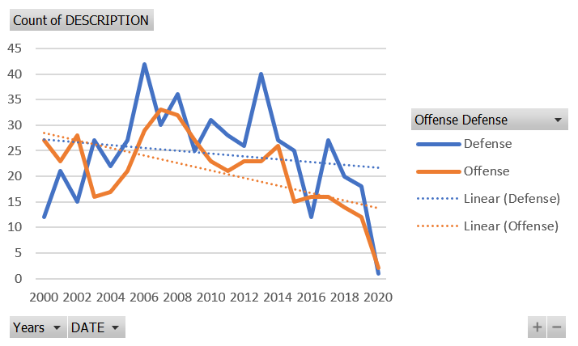
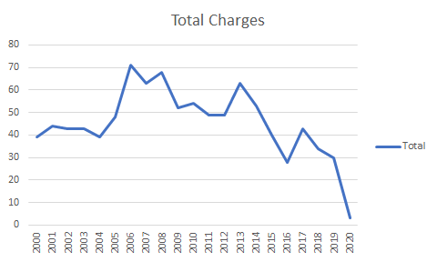
Line Graph of Total Crimes Per Year
Both offense and defense athletes are trending down from a total crimes committed

Slide 4
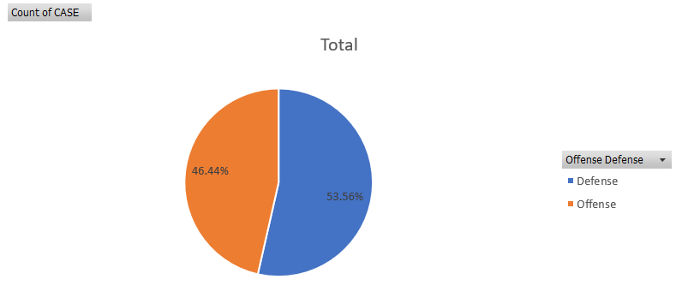
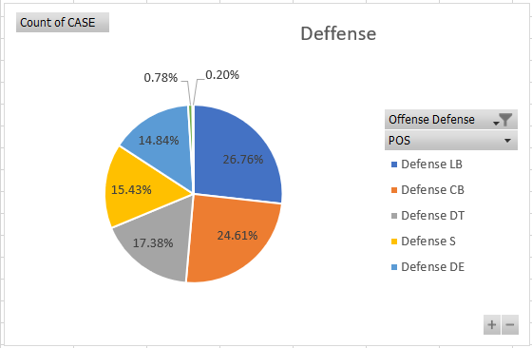
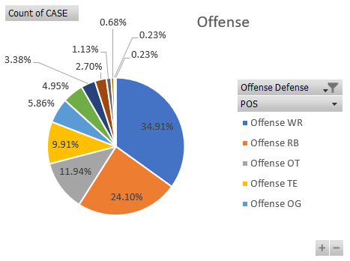
Pie Chart Crime by Offense or Defense
What do we learn about this?
Defensive players have a greater % of crimes committed.
What kind of Crimes are they committing?

Slide 5
HEADER – TOPIC/QUESTION
CODE IMAGE
VISUALIZATION
ANALYSIS

Slide 6
HEADER – TOPIC/QUESTION
CODE IMAGE
VISUALIZATION
ANALYSIS

